Slide 1
Customer Insights and Analysis
Capstone Project
Yogita Mane Data Scientist 15th April '23

Slide 2
About Me
Education
Work Experience
Interest in Data Science
Studied Human Resources and Business Management
Currently working in NZI handling claims
Currently learning Data Science
10 years of experience in the field of claims management
Exploring the learning process of Data Science
Former business owner (pre-Covid)
Seeking to pursue a career in Data Science
Telco industry is competitive and being my past work experience, it has urged me to explore further on User behaviour from a marketing perspective.

Slide 3
Industry Background
Telecommunication Industry This teleco company in New Zealand provides mobile and fixed-landline, internet, broadband services, cloud computing, digital and IT services, as well as a range of devices. Committed to customer service, it offers multiple channels for customers to seek assistance with self-service options. With an innovative and investment in its network infrastructure and digital services, it ensures the connectivity of people and businesses throughout the world.
Problem/ Challenges This industry has a challenging task of understanding its broad and diverse user base in order to create tailored products and services. User journeys in the industry are complex and difficult to track, leading to difficulty optimizing user experience. Companies often lack reliable data on user behaviour due to siloed, outdated, or incomplete data. Furthermore, data privacy and security regulations limit the amount of data available for analysis, making it hard to gain comprehensive understanding of user behaviour/engagement.

Slide 4
Business Question
“What strategies can we use to improve the conversion rates of e-commerce platform for different age groups and genders?” We want to understand engagement patterns to tailor product offerings and increase purchase likelihood.

Slide 5
Data Source
Dataset submitted is a Company Data, introduced by Marketing Lead in question to gain insights into age & gender behaviour on their e-commerce platform, facing challenges such as lack of understanding target audience, ineffective messaging, poor user experience, & inadequate data analysis.
Data is sourced from Google Analytics, this allows business to tracks and reports website traffic as a platform inside the Google Marketing Platform. In future, this dataset can be made available through Marketing Team.
Data Question as a Data Scientist be, “What data variables are needed to accurately analyse customer behaviour and identifying opportunities for optimisation”.
Data required to analyse data, as follows but not limited to; Demographic data - Age, gender, location, and other demographic information of customers Website traffic data - Gain insight into customer interaction on the e-commerce platform, such as visitor numbers, session duration, bounce rate and exit rate. Marketing campaign data: Marketing campaign data can provide insights on traffic, conversion rates, etc. User behavior data: Gather customer data to track page visits, product views, and platform navigation.

Slide 6


























Data Flow Chart
1.2 Context
1.1 Telco Industry
$
$
2 Business Question
7 Business Question
3 Data Question
5 DATA SCIENCE PROCESS
6 Data Question
4 Identify, locate and source
9 Consider how the solution can be implemented
Iterate
Data
Ask a question
Explore data
Model and validate
Communicate
Ask a question
Solution

Slide 7
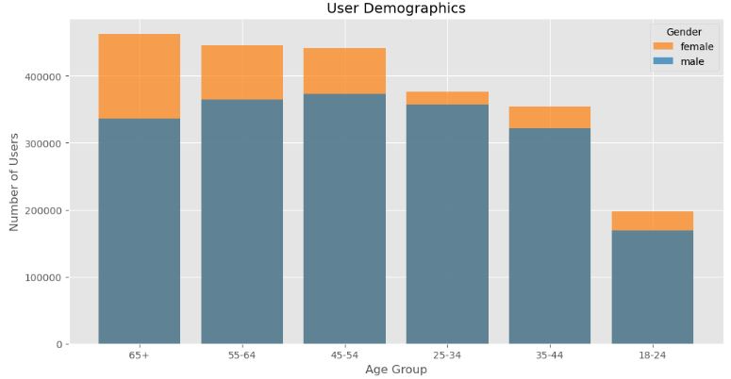
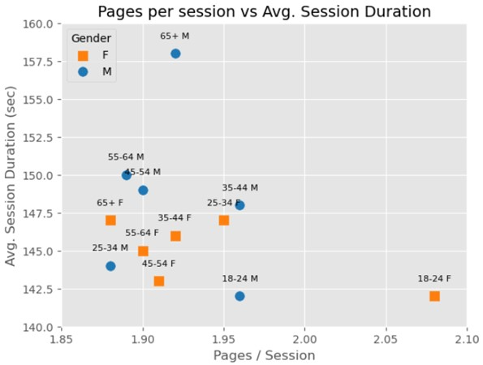
Explanatory Data Analysis
Older users (65+, 55-64, & 45-54) are evenly distributed, & females make up a majority in each age group. These trends suggest businesses should target products/services towards women's interests and needs.
Males aged 25-34 have the highest bounce rate at 69.67%, while females aged 65+ have the highest at 67.26%.
Younger age groups (18-24 and 25-34) tend to spend more time on the site and view more pages than older age groups, with females 18-24 exhibiting highest engagement. Tailoring content and UX (User experience) for these demographics could lead to increased engagement and satisfaction.
Younger age groups (18-24 and 25-34) have more website transactions and revenue than older groups, as seen in the transaction rate, revenue, and e-commerce conversion rate.
Pages/Session refers to the average number of pages viewed in a website session. Pages/Session range from 1.88-2.08, with the highest value for 18-24 female age group. Avg. Session Duration is the average time spent on the website per session, with a range of 00:02:22-00:02:38, highest value for 65+ male age group.
Female customers aged 25-34 are our most active and valuable segment, generating highest revenue.
18-24 year-olds have highest conversion rate. To capitalize on these insights, let's focus our efforts on personalizing their experience to increase customer loyalty and develop products or services tailored to their interests.

Slide 8
Feature Engineering
We have added new features to provide insights into customer behaviour to inform decision-making;
Sessions per User: The sessions per user metric can be used to understand the frequency at which users are interacting with the website. The 18-24 age group has an average of 3.5 sessions per user, while the 65+ age group has 4.8. Business can use this insight to tailor their marketing and increase website engagement.
Average Order Value: The 18-24 age group has the highest average order value (NZ$766), while 65+ have the lowest. This can enable business to create age-specific offers to increase revenue per order.
Revenue per User (RPU): An important metric that helps businesses understand how they generate revenue. The 25-34 age group earns the highest RPU, showing its value to the business. This insight can be used to create targeted marketing strategies to increase RPU in other age groups.

Slide 9

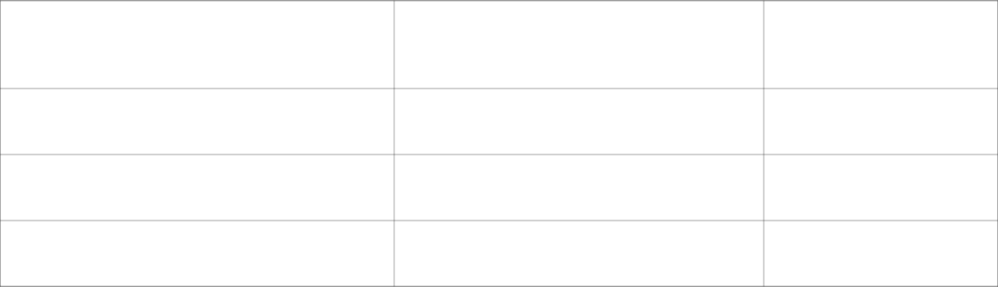
Modelling and their Evaluation Metrics
We have analysed the performance of Random Forest Regressor, Linear Regression, and Support Vector Regression to understand their effectiveness.
The Random Forest Regressor has a higher MSE and lower accuracy than other models, yet its R-squared value is highest. Its learning curve shows no signs of over/underfitting and suggests generalizability.
The Linear Regression model has the lowest MSE of 0.615, but its R-squared value is the lowest at 0.155. This suggests that the Linear Regression model may not capture complex relationships between the independent and dependent variables, and the learning curve suggests that it may not be complex enough to capture underlying patterns in the data.
Mean Squared Error
R-squared
Random Forest Regressor
0.691
0.524
Linear Regression
0.615
0.155
Support Vector Regression
1.775
-0.461
The Support Vector Regression model has a high MSE of 1.775 and negative R-squared value of -0.461, indicating it is not a good fit and unable to generalize well to unseen data. The learning curve also shows scores declining as training examples increase. Random Forest Regressor model seems to be the best fit for the data based on its high R-squared value, even though it has a higher MSE compared to the Linear Regression model. This can help business to make informed decisions about marketing and sales strategies, product development, and resource allocation.

Slide 10







Summary
The highest revenue per user is generated by the 25-34 age group, both male and female. This can be used to create targeted marketing campaigns tailored to specific age groups to increase their revenue per user.
The age groups with the highest number of users are 45-54 and 55-64, both male and female.
The 18-24 age group has the lowest number of users, both male and female.
The highest average order value is found in the 18-24 age group, both male and female. This insight can be used to create targeted promotions and offers that increase the average order value for specific age groups.
The bounce rate for all age groups is above 0.65, which suggests that a significant number of users leave the website after visiting only one page.
The highest conversion rate is found in the 18-24 age group, both male and female, indicating that they are more likely to make a purchase on the website. While users aged 65+ have the lowest, who most likely visit instore for purchase.
The average number of pages per session is highest for the 18-24 age group, both male and female, which suggests that they are more engaged with the website than other age groups.

Slide 11
Next steps
- Analysis of website design, content, and usability can reduce bounce rates by improving users' overall experience.
- The average session duration of users is 2-3 minutes, which is decent but can be improved. Examining website design, content, and user flow can increase the average session duration and encourage users to engage more deeply with the site.
- High bounce rates across all age and gender groups show users are not finding what they need on the website. Enhancing design, content and usability can improve user experience and reduce bounce rates.
- By analyzing bounce rates and average session duration, business can optimize their website for a better user experience, such as improved navigation, page load times, and relevant content.
- It is important to analyze user demographics, as most users in the age group of 25-34 with slightly more female users. This information can be used to create targeted marketing strategies that cater to each age & gender group's needs & preferences.
- By analyzing bounce rate and session duration for each demographic, we can take a data-driven approach to optimizing our website and improve the user experience, increasing conversion into customers.
- To improve conversion rates, we recommend creating targeted campaigns for different demographics, with tailored messaging, imagery, and tone. Additionally, personalized promotions and discounts can be offered.

Slide 12
Questions

Slide 13
Appendices
https://www.smartdatacollective.com/customer-behavior-analysis-telecom-arena/
https://www.plecto.com/blog/sales-performance/importance-data-analytics-telecom-industry/
https://www.scuba.io/blog/how-to-conduct-a-behavioral-analysis
https://www.dataquest.io/blog/learning-curves-machine-learning/

Slide 14
Thank you

